Slide 1
CSE308:COMPUTING PRACTICUM-IV
Unit 1: Improving Command-line productivity
• Writing Simple Bash Scripts • Running commands More Efficiently Using Loops • Matching Text in Command Output with Regular Expressions
Outcome: Understand Bash scripts to schedule various tasks

Slide 2
Shell Scripts
Basically, a shell script is a text file with Unix commands in it.
Shell scripts usually begin with a #! and a shell name
For example: #!/bin/sh (She bang)
If they do not, the user's current shell will be used
Any Unix command can go in a shell script
Commands are executed in order or in the flow determined by control statements.
Different shells have different control structures
The #! line is very important
We will write shell scripts with the Bourne shell (sh)

Slide 3
Shell Scripts
Why write shell scripts?
To avoid repetition:
If you do a sequence of steps with standard Unix commands over and over, why not do it all with just one command?
To automate difficult tasks:
Many commands have subtle and difficult options that you don’t want to figure out or remember every time.

Slide 4
Steps in Writing a Shell Script
Write a script file using vim:
The first line identifies the file as a bash script.
#!/bin/bash
Comments begin with a # and end at the end of the line.
give the user (and others, if (s)he wishes) permission to execute it.
chmod +x filename
Run from local dir
./filename
Run with a trace – echo commands after expansion
bash –x ./filename

Slide 5
Variables(Untyped)
Create a variable
Variablename=value (no spaces, no $)
read variablename (no $)
Access a variable's value
$variablename
Set a variable
Variablename=value (no spaces, no $ before variablename)

Slide 6
Variables(Untyped)
Local variables
Environmental variables
$HOME $SHELL $PATH
Positional variables

Slide 7
Positional Variables(Parameters)
These are also called command line arguments.
$0 name of the script
$1 first argument
$2 second argument
$3 third argument
$# total number of arguments
$* value of all arguments

Slide 8
Positional Variables(Parameters)
$vim filename.sh
touch $1 $2
echo “files created”
echo “Total number of arguments passed $#”
echo “vale of the arguments passed is $*”
Save this and make it executable and run
$./filename.sh abc def (abc and def are file names which are passed as arguments)

Slide 9
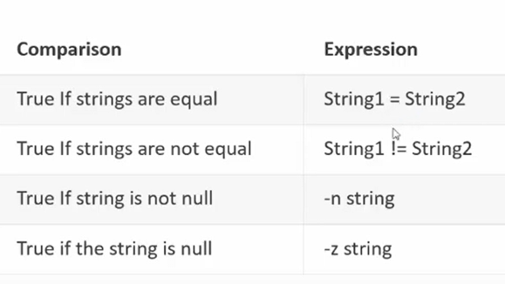
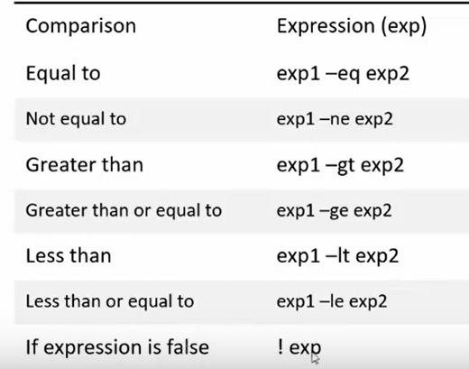
Operators ( || or &&)

Slide 10
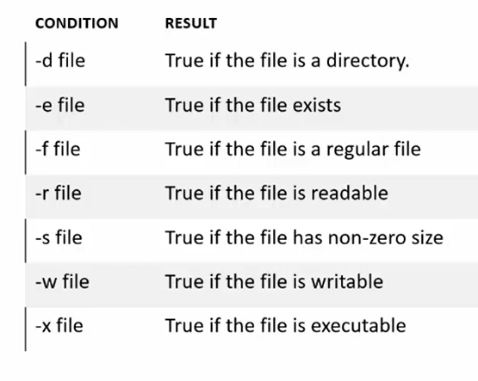
Operators

Slide 11
Scripts for commands
$Vim scriptname.sh
date
ls
cal
Save the file by using shift+; and write wq
Then give execute permission to the file scritname.sh
$ chmod +x scriptname.sh
$ ./scriptname.sh (if you are in current working directory)
$ bash scriptname.sh( u can also use this method to run a script)

Slide 12
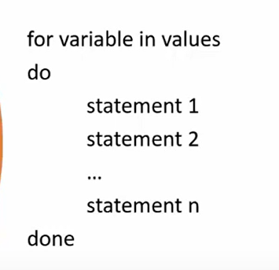
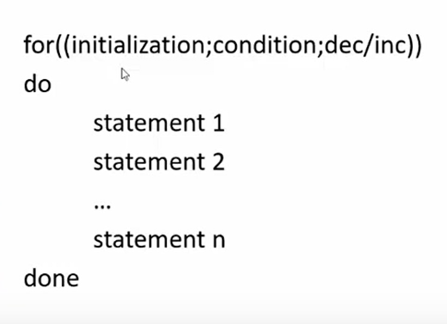
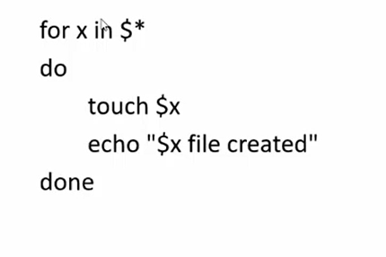
For Loop

Slide 13
Simple Script
### Script to print user information who currently login , current date & time
#clear
echo "hello $USER“
echo –e "today is \c ";date
echo –e "number of user login : \c"; who | wc –l
echo "calander“;cal
exit 0

Slide 14
Script to add two Numbers
echo enter the no
read a
echo enter 2nd no
read b
c=`expr $a + $b`
echo the sum is $c

Slide 15
Script to Multiply two Numbers
echo enter num1
read a
echo enter num2
read b
c=`expr $a \* $b`
echo The Multiplication of Number are $c

Slide 16
Switch Case
echo enter first no.
read n1
echo enter second num.
read n2
echo "enter your choice“
echo 1. to add
echo 2. to subtract
echo 3. to divide
echo 4. to multiply
read choice
case $choice in1) n3=`expr $n1 + $n2`echo num is $n3;;
2)n4=`expr $n1 - $n2`echo difference is $n4;;
3)n5=`expr $n1 / $n2`echo division is $n5;;
4)n6=`expr $n1 \* $n2`echo multiplication is $n6;;*)
echo your choice is wrong;;
esac

Slide 17
Simple If (-eq –ne –gt –ge lt –le !exp)
echo "Input number“
read number
if [ $(($number % 2)) -eq 0 ]
then
echo "$number is even “
else
echo "$number is odd“
fi
exit 0

Slide 18
If Elif
elif test $a -eq $b
then
echo a nd b are equal
elif test $b -eq $c
then
echo b nd c are equal
elif test $a -eq $cthen
echo a nd c are euqal
else
echo numbers are not equal
fi
echo "Enter The First number“
read a
echo "Enter the 2nd numger“
read b
echo "Enter 3rd number“
read c
if test $a -eq $b -a $a -eq $c
then
echo a and b and c are equal

Slide 19
While Loop
## WAP in Shell to print Factorial of any Number
echo Enter the number
read n
fact=1
while (($n > 1));
Do
fact=`expr $fact \* $n`
n=`expr $n - 1`
Done
echo Factorial of the number is $fact

Slide 20
Check whether the number is >100 or not
echo enter the number
read n
if (($n>100))
echo the umber is greater
Else
echo the number is smaller than 100
fi

Slide 21
Print days of week as per the day number
read choice
if [ $choice -eq 1 ] ; then
echo Monday
elseif [ $choice -eq 2 ] ; then
echo Tuesday
elseif [ $choice -eq 3 ]; then
echo Wednesday
elseif [ $choice -eq 4 ]; then
echo Tursday
elseif [ $choice -eq 5 ]; then
echo Fridayelseif [ $choice -eq 6 ]; then
echo Saturday
elseif [ $choice -eq 7 ]; then
echo Sunday fi fi fi fi fi fi fi
# Script of nested if statement
# print day of Weak
choice=0
echo 1. Monday
echo 2. Tuesday
echo 3. Wednesday
echo 4. Tursday
echo 5. Friday
echo 6. Saturday
echo 7. Sunday

Slide 22
# Script to find whether the entered character is vowel or not#
echo Enter a character
read ch
if [$ch=='a' -o $ch=='e' -o $ch=='i' -o $ch=='o' -o $ch=='u’]
Then
echo Character is vowel
else echo character is not vowelfi
exit 0

Slide 23
Sequence of Numbers
num=1
while (($num < 10));
do
echo $num
let num++
done

Slide 24
Continue and break
for ((i=1;i<10;i++))
Do
if (($i < 3))
Then
echo "continue“ continue
Fi
echo $i
if (($i > 8))
Then
echo "break"break
Fi
done

Slide 25
Table of a number
echo "enter the number whose table u want“
read ni=1
while (( $i <= 10 ));
do
out=`expr $n \* $i`
echo $n"*" $i"=" $out
let i++
done

Slide 26
Cube
echo Enter number up to You want cube
read n
num=1
while (($num <= n));
do cube=`expr $num \* $num \* $num`
echo $cube
num=`expr $num + 1`
done

Slide 27
For Loop
for flc in $(seq 1.0 .01 1.1)
do
echo $flc;
done

Slide 28
Print a series from 1 to 10
##WAP in Shell to print number 1 to 10
for (( i=1 ; i <= 10 ; i++ )) ## i is a variable
do
echo $i ;
done

Slide 29
If else if else fi fi
#nestedif.sh
osch=0
echo "1. Unix (Sun Os)“
echo "2. Linux (Red Hat)“
echo -n "Select your os choice [1 or 2]? “
read osch
if [ $osch -eq 1 ] ; then
echo "You Pick up Unix (Sun Os)“
else
if [ $osch -eq 2 ] ; then
echo "You Pick up Linux (Red Hat)"
else
echo "What you don't like Unix/Linux OS."
fi
fi

Slide 30
Scripts for commands
$Vim scriptname.sh
date
ls
cal
Save the file by using shift+; and write wq
Then give execute permission to the file scritname.sh
$ chmod +x scriptname.sh
$ ./scriptname.sh (if you are in current working directory)
$ bash scriptname.sh( u can also use this method to run a script)

Slide 31
TASK TO DO
Write a script to create two directories and name of the directories must be passed by the you. Read dir1 dir2 mkdir $dir1 $dir2
Write a script to change the name of the file. Ask from user the old file name and new file name.
Write a script to rename a file and names must be passed as command line arguments. mv $1 $2 echo “name changed”
Write a script whether a file exists if not then create it.
Read name If [ -f $fname ] then echo “file exist” else touch $fname

Slide 32
TASK TO DO
Write a script that takes two command line arguments. Check whether the name passed first is directory or not. If not then create a new directory with name passed a second argument. If [ -d $1 ] then echo “director “ else mkdir $2 echo “dir created
Write a script to check total numbers of arguments . If arguments are >5 then print “too many arguments exists”.
Write a script to check whether the command line argument is dir or file.
Write a script to read a month name from user and check whether it is march or April. fi

Slide 33
“grep” Matching Text in Command Output with Regular Expressions
Look for some content in file (case sensitive)
Print lines which contains pattern
$grep [options] pattern [file]
$grep “apple” filename.txt (it shows the line where it is present, grep will look for apple in whole file or if is a part of file)
$grep –w “apple” filename.txt (looks for word apple only in the file)
$grep –n “apple” filename.txt (prints line numbers)
$grep –c “apple” filename.txt (to count the lines where it is present)

Slide 34
“grep”
$grep -i “apple” filename.txt (to remove case sensitivity from file)
$grep -v “apple” filename.txt (print lines where apple is not present)
$ grep -v “apple” filename.txt (print lines where apple is not present)
grep ”echo” *.sh (print names of all files containing data “echo”)
grep -l ”echo” *.sh (print only names of all files containing data “echo”)
grep –e “apple” –e “banana” filename.txt (to search for multiple patterns (or search))

Slide 35
“grep” Answer these questions
$grep -vi “apple” filename.txt
$grep “Apple” filename.txt
$grep -cv “apple” filename.txt

Slide 36
“grep” with Regular Expressions
Regular expression is sequence of characters which helps to define patterns
*(asterisk) zero or more occurrences of previous character
$ grep “ap*le” filename.txt
.(dot) anyone character
$ grep “ap.le” filename.txt
[] one specific character
$ grep “app [acp]e” filename.txt

Slide 37
“grep” with Regular Expressions
Regular expression is sequence of characters which helps to define patterns
^(not) any character except
$ grep “app [^acp]e” filename.txt
[a-d] for range
$ grep “app [a-z]e” filename.txt
$ grep “app [^a-z]e” filename.txt
$ grep “app [a-z0-9]e” filename.txt
$ grep “app [^a-z0-9]e” filename.txt

Slide 38
“grep” with Regular Expressions
Regular expression is sequence of characters which helps to define patterns
^ line beginning with
$ grep “^app” filename.txt
$ grep “^[a-z0-9]” filename.txt
$ grep “^[^a-z]” filename.txt
$ lines ending with
$ grep “e$” filename.txt
$ grep “[a-z]$” filename.txt

Slide 39
“grep” with Regular Expressions(Extended)
Regular expression is sequence of characters which helps to define patterns
+ 1 or more occurrences of previous character
$ grep –E “ap+le“ filename.txt
? Zero or one occurrences of previous character
$ grep –E “ap?le“ filename.txt
{m,n} m Minimum n Maximum
$ grep –E “ap{2,4}le“ filename.txt
$ grep –E “ap{2,}le“ filename.txt
$ grep –E “ap{,4}le“ filename.txt

Slide 40
“grep” with Regular Expressions(Extended)
Regular expression is sequence of characters which helps to define patterns
() one word
$ grep –E “ap(ple|pple)“ filename.txt
if i am looking for apple or apple

Slide 41
“grep” Tasks
Write command to count the lines not beginning with lowercase alphabet?
$grep “^[^a-z]” filename.txt
Write a command to search for empty lines?
$grep “^$” filename.txt
Write a command to search for a lines starting and ending with a digit?
$grep “^[0-9].*[0-9]$ filename.txt (.* means any character can come any number of times)
Write the command to search for lines containing only digit?
$grep –E “^[0-9]+$” filename.txt

Slide 42
THANKS

